Slide 1
Key Findings FROM RECOMMENDATION SYSTEM
Data Visualization By Nomcebo Thwala

Slide 2
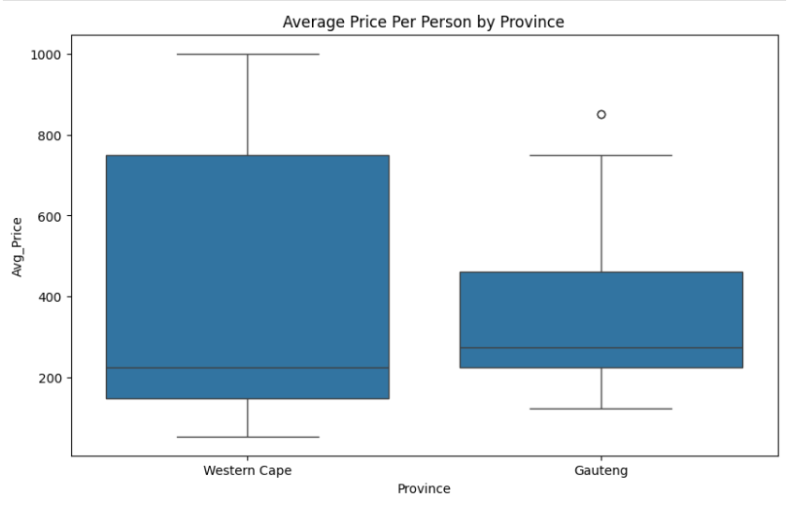
Analysing Average meal Price Per Person by Province(Western Cape & Gauteng)
"This boxplot visualizes the distribution of the average price per person (Avg_Price) at restaurants in two provinces: Western Cape and Gauteng. It allows us to compare the typical price ranges and identify potential outliers in each region.“
Observations:
Price Differences: Restaurants in the Western Cape generally have a higher average price per person compared to restaurants in Gauteng.
Price Range: The Western Cape exhibits a wider range of average prices, indicating a greater variety of dining options from budget-friendly to high-end.
Gauteng's Price Range: Gauteng shows a narrower range of average prices, suggesting a more concentrated price segment.
Outliers: Both provinces have potential outliers at the higher end of the price range, representing exceptionally expensive restaurants.
Relevance to Current Location: As my current location is Johannesburg, Gauteng, this graph shows that generally restaurants in my province tend to be cheaper than restaurants in the Western Cape.

Slide 3
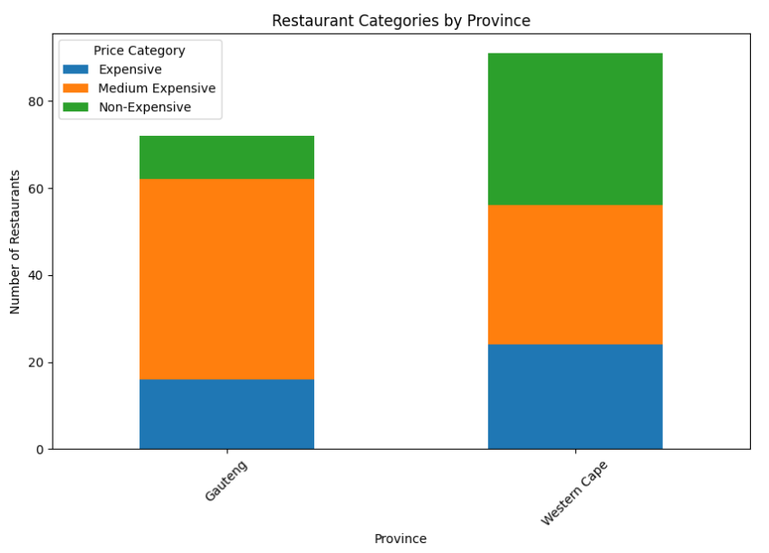
Analysis of Restaurant Price Categories by Province (Gauteng & Western Cape)
"This stacked bar chart visualizes the distribution of restaurant price categories (Expensive, Medium Expensive, and Non-Expensive) across Gauteng and Western Cape. It allows us to compare the composition of restaurant price ranges in these two provinces.“
Observations:
Western Cape Dominance: Western Cape has a significantly higher number of restaurants across all price categories compared to Gauteng.
Gauteng's Price Focus: While Gauteng has fewer restaurants overall, it maintains a considerable amount of medium expensive restaurants.
Non-Expensive in Western Cape: Western Cape has a large number of "Non-Expensive" restaurants, potentially indicating a wider range of budget-friendly options.
Overall Restaurant Count: Western Cape has a much larger restaurant market than Gauteng.
Relevance to Current Location: As my current location is Johannesburg, Gauteng, this graph shows that there are less restaurants in my province, than in the Western Cape.

Slide 4
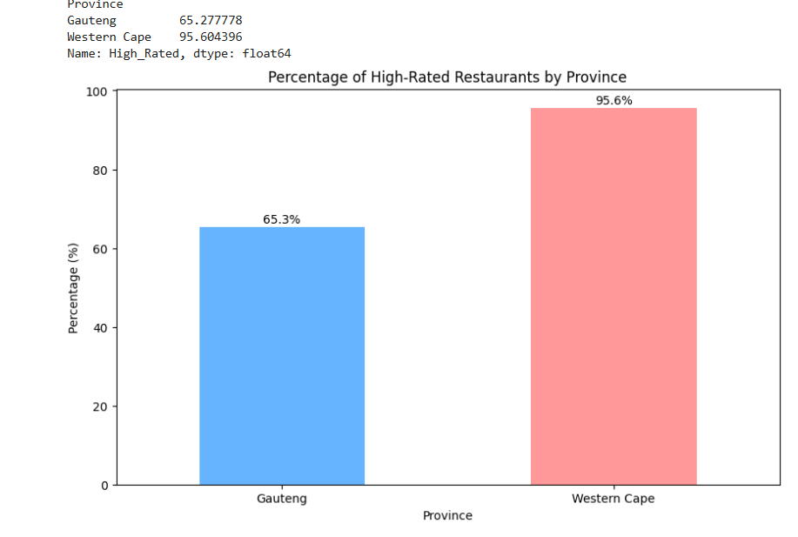
Percentage of High-Rated Restaurants by Province
"This bar chart visualizes the percentage of high-rated restaurants in Gauteng and Western Cape. It helps us understand the distribution of high-rated restaurants across these two provinces.”
Observations:
Western Cape Superiority: Western Cape has a significantly higher percentage of high-rated restaurants (95.6%) compared to Gauteng (65.3%).
High :Rating in Western Cape The exceptionally high percentage of high-rated restaurants in Western Cape suggests a high standard of restaurant quality in that region.
Moderate Rating in Gauteng: While still above average, the percentage of high-rated restaurants in Gauteng is notably lower than Western Cape.
Provincial Disparity: There is a substantial difference in the percentage of high-rated restaurants between the two provinces, indicating a potential regional quality difference.
Relevance to Current Location: As my current location is Johannesburg, Gauteng, South Africa, this graph shows the percentage of high-rated restaurants in my province. This is important information for the model to use when making recommendations.

Slide 5
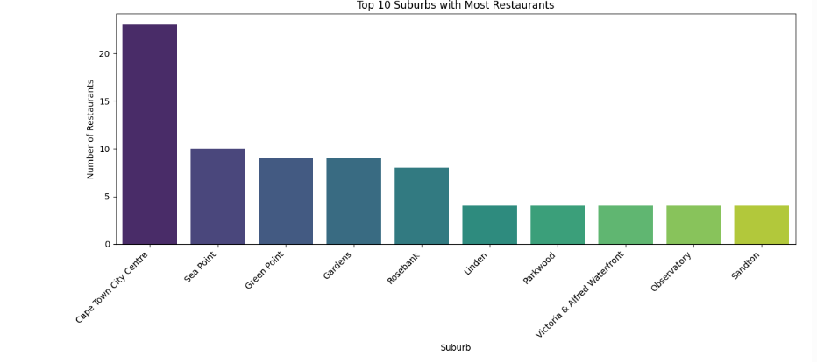
Top 10 Suburbs with The Most Restaurants across both provinces (Gauteng & Western Cape)
"This bar chart displays the top 10 suburbs with the highest number of restaurants. It helps us understand the concentration of restaurants in these areas.“
Observations:
Cape Town City Centre Lead: Cape Town City Centre has a significantly higher number of restaurants compared to other suburbs.
Decreasing Trend: The number of restaurants decreases progressively from Cape Town City Centre to Sandton.
Restaurant Concentration: The chart highlights suburbs with a high concentration of restaurants.
Geographic Mix: The suburbs listed are from both Cape Town and Johannesburg, showing a mix of high-restaurant-density areas.
Johannesburg Insight: The inclusion of Johannesburg suburbs like Rosebank, Linden, Parkwood, Observatory, and Sandton provides insight into restaurant density in my area.
Relevance to Current Location: As my current location is Johannesburg, Gauteng, South Africa, this graph shows the top 10 suburbs with the most restaurants. This is important information for the model to use when making recommendations.

Slide 6
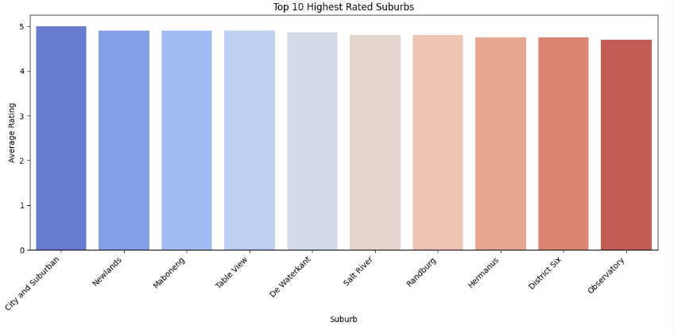
Top 10 Highest Rated Suburbs
"This bar chart displays the average ratings of the top 10 highest-rated suburbs in the dataset. It helps us understand the quality and consistency of restaurant ratings in these top-performing areas.“
Observations:
Exceptional Ratings: All 10 suburbs have exceptionally high average ratings, indicating a high level of quality.
Low Rating Variance: The average ratings show minimal variation, suggesting consistent quality across these top suburbs.
Top Performer: "City and Suburban" stands out with the highest average rating.
Quality Indicator: This chart highlights the high quality of restaurants found in these suburbs.
Geographic Diversity: The suburbs listed are from various locations, indicating a broad range of high-rated areas.
Relevance to Current Location: As my current location is Johannesburg, Gauteng, South Africa, this graph shows the top 10 highest rated suburbs. Even though the graph is not limited to Johannesburg, the data shows the high ratings that the model is working with.

Slide 7
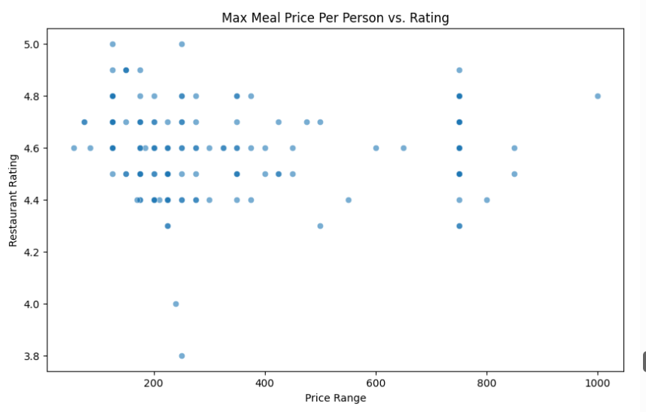
Max Meal Price Per Person vs. Rating
"This scatter plot visualizes the relationship between the maximum meal price per person and the restaurant rating. It helps us understand if there is any correlation between these two variables.“
Observations:
No Price-Rating Correlation: The scatter plot shows no clear linear trend between price and rating, indicating that price does not strongly predict rating.
Wide Price Variation at High Ratings: Restaurants with high ratings exhibit a wide range of prices, suggesting that quality is not solely determined by cost.
Varied Ratings at Lower Prices: Restaurants with lower prices still show a wide range of ratings, further reinforcing the lack of correlation.
Sparse High-Price Data: There are very few restaurants with extremely high meal prices in the dataset.
No Obvious Patterns: The lack of clear clusters or patterns suggests that price and rating are relatively independent variables.
Relevance to Current Location: While this graph is not limited to Johannesburg, Gauteng, South Africa, it shows that price and rating are independent variables. This is important information for the model to use when making recommendations.

Slide 8
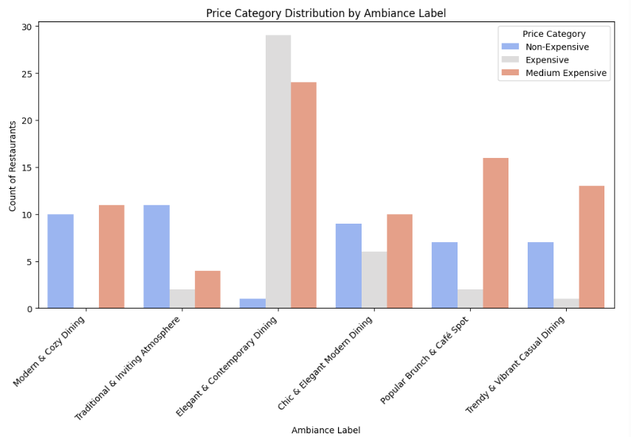
Price Category Distribution by Ambiance Label
"This grouped bar chart visualizes the distribution of price categories (Non-Expensive, Expensive, and Medium Expensive) across different ambiance labels. It helps us understand the relationship between ambiance and price range in restaurants.“
Observations:
Ambiance and Price Correlation: Certain ambiance labels correlate with specific price categories. For example, "Elegant & Contemporary Dining" and "Chic & Elegant Modern Dining" have a higher count of medium-expensive restaurants.
Medium Expensive Dominance: "Medium Expensive" restaurants are more prevalent across most ambiance categories.
Budget-Friendly Brunch: "Popular Brunch & Café Spot" tends to have more "Non-Expensive" restaurants.
Balanced Distribution: "Modern & Cozy Dining" and "Traditional & Inviting Atmosphere" show a more balanced distribution of price categories.
Relevance to Current Location: As my current location is Johannesburg, Gauteng, South Africa, this graph shows the relationship between ambiance and price. This is important information for the model to use when making recommendations.

Slide 9
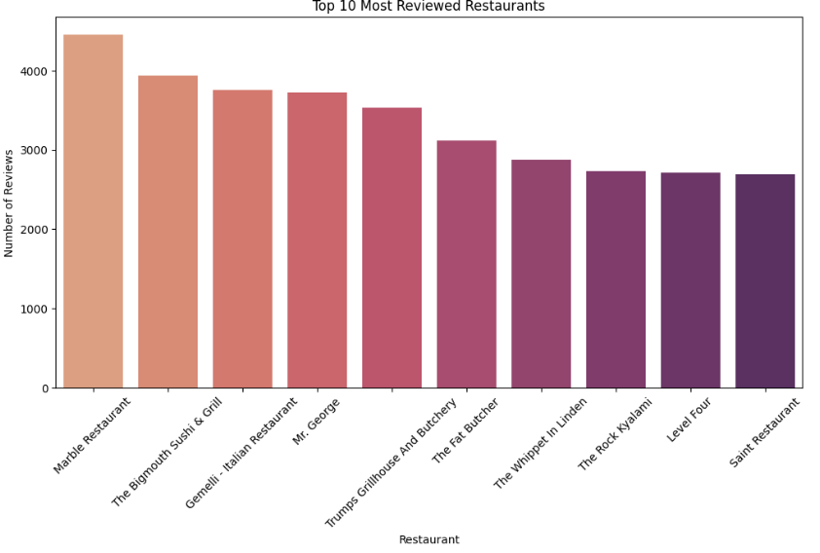
Top 10 Most Reviewed Restaurants
"This bar chart visualizes the top 10 most reviewed restaurants, with the height of each bar representing the number of reviews received. It helps us understand the popularity and visibility of these restaurants based on user feedback.“
Observations:
Marble Restaurant Dominance: Marble Restaurant stands out with a significantly higher number of reviews compared to other restaurants.
Popularity Indication: The number of reviews can be an indicator of a restaurant's popularity and visibility.
Review Disparity: There is a noticeable disparity in the number of reviews, with a significant drop after Marble Restaurant.
Top 10 List: The chart provides a clear overview of the top 10 most reviewed restaurants in the dataset.
Relevance to Current Location: As my current location is Johannesburg, Gauteng, South Africa, this graph shows the top 10 most reviewed restaurants. This is important information for the model to use when making recommendations.

Slide 10
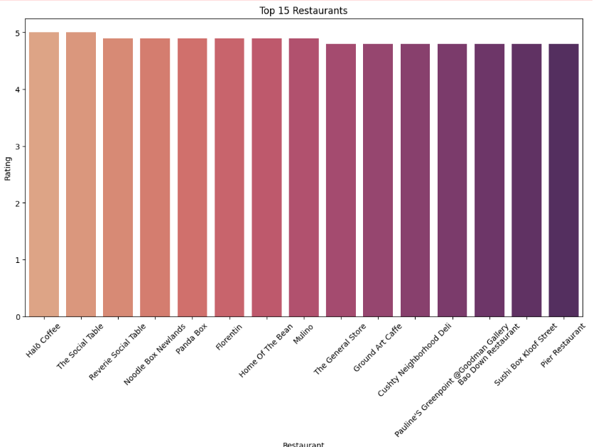
Top 15 Restaurants (by Rating)
"This bar chart displays the ratings of the top 15 highest-rated restaurants in the dataset. It helps us understand the quality and consistency of these top-performing restaurants."
Observations:
Exceptional Ratings: All 15 restaurants have exceptionally high ratings, indicating a high level of quality.
Low Rating Variance: The ratings show minimal variation, suggesting consistent quality across these top restaurants.
Top Performers: Halo Coffee and The Social Table stand out with the highest ratings.
Quality Indicator: This chart highlights the high quality of restaurants that are being rated.
Relevance to Current Location: While this graph is not limited to Johannesburg, Gauteng, South Africa, it shows the range of high ratings that the model is working with. This is important information for the model to use when making recommendations.

